Slide 1
Section 7.4 Midpoint and Distances
© Copyright all rights reserved to Homework depot: www.BCMath.ca

Slide 2
Finding the Middle Point:
When given the endpoints of a line segment, the middle can be found by finding the average of the endpoints

Slide 3
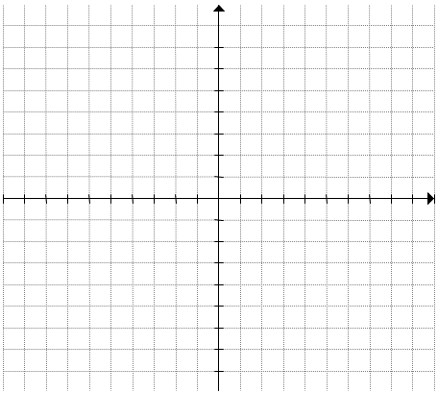
IV) Midpoints
When given the endpoints of a line, the midpoint can be found by taking the average of the coordinates
Ex: Given the points A(-3,1) and B(6,9), find the coordinates of the midpoint
Take the average of the two “x” coordinates to find the x-coordinate of the midpoint
The coordinates of the midpoint will then be:

